Slide 1
Year 4– Science – Autumn 1
States of Matter
What I have learned already:
I know that materials have different properties (Yr 1), have different purposes (Yr 2) and different physical properties (Yr 3).
Key statements:
A solid keeps its shape and has a fixed volume.
A liquid has a fixed volume but changes in shape to fit the container. A liquid can be poured and keeps a level, horizontal surface.
A gas fills all available space; it has no fixed shape or volume.
Activity: Investigate how to melt ice more quickly and how to change the rate of evaporation.
Key words: solid, liquid, gas, heating, cooling, state change, melting, freezing, melting point, boiling, boiling point, evaporation, condensation, temperature, water cycle

Slide 2
Year 4 – Science – Autumn 2 – Animals including Humans
Key Statements:
The mouth, oesophagus, liver, stomach, pancreas, small intestine, large intestine, rectum and anus are all parts of the digestive system.
Adults have 32 teeth.
There are four types of teeth: incisors for cutting; canines for tearing; and molars and premolars for grinding.
Key words: Digestive system, digestion, mouth, teeth, saliva, oesophagus, stomach, small intestine, nutrients, large intestine, rectum, anus, teeth, incisor, canine, molar, premolars
What I have learned already:
I have named different parts of the body
(Yr 1),
I know that offspring grow into adults and how to keep my body healthy (Yr 2),
I understand about nutrition (Yr 3)
Activities: Research the parts of the digestive system. Create a model of the digestive system.
Explore eating different types of food to identify which teeth are being used for cutting, tearing and grinding.

Slide 3
What have I learned already:
I have learned already that materials are used for different purposes and that there is renewable energy (Yr 2). I know that there are different sources of light (Yr 3).
Year 4 – Science – Spring 1 – Electricity
Key Statements:
A complete circuit is an uninterrupted path for electrons to flow from an energy source.
Recognise that a switch can be added to the circuit to turn the component on and off.
Electrical conductors enable electricity to pass through them easily.
Insulators do not allow electricity to pass through them.
Key words: Electricity, electrical appliance/device, mains, plug, electrical circuit, complete circuit, component, cell, battery, positive, negative, connect/connections, loose connection, short circuit, crocodile clip, bulb, switch, buzzer, motor, conductor, insulator, metal, non-metal, symbol
Activities: Can you make a light bulb work without using any wires?
Can you apply your knowledge of conductors and insulators to design and make different types of switches?

Slide 4
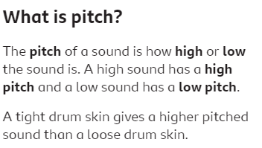
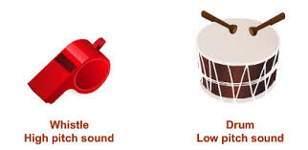
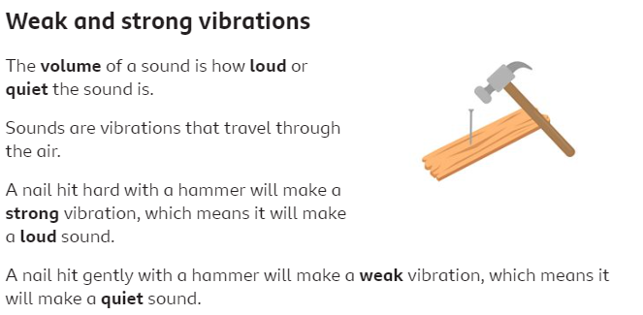
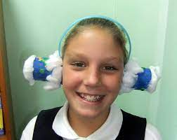
Year 4 – Science – Spring 2- Sound
Key words: sound, source, vibrate, vibration, travel, pitch (high, low), volume, faint, loud, insulation, medium
What I have learned already:
I know that sound is one of the senses and that the ear plays a part in the process of hearing (Yr 1)
Key statements:
Sounds are made when objects vibrate.
Vibrations travel through a medium from the source to our ears.
Different mediums such as solids, liquids and gases can carry sound.
The vibrations cause parts of our body, inside our ears to vibrate, allowing us to hear (sense) the sound.
Activities: Which materials are the best sound insulators and make the best earmuffs?
How could we measure the sound of the triangle at different distances?
How can you change the pitch on these instruments?

Slide 5
Year 4 – Science – Summer 1 - Living things and their habitats
Key Statements:
Recognise that living things can be grouped in different ways according to their features.
Recognise that environments change:
naturally e.g. through flooding
because of humans
because of the seasons
What I have learned already : I have learned to describe mammals, amphibians, reptiles, fish and birds. (Y1) I have learned that living things live in an environment to which they are suited (Y2) and that animals need to eat in order to get the nutrients they need (Y3).
Key words: classification, classification keys, environment, habitat, human impact, positive, negative, migrate, hibernate
Activities: How can I use this classification key to name an unknown living thing?
Can I create my own classification key based on observable features?
Can I use secondary sources to find out about human impact on environments?

Slide 6
Classify animals as herbivores, carnivores or omnivores according to the type of teeth they have in their skulls.
Use food chains to identify producers, predators and prey within a habitat.
Year 4 – Science – Summer 2 – Animals, including humans: food chains
Key Statements:
A producer produces its own energy - such as a tree
A predator is an animal that naturally preys on others
Prey is an animal that is caught and killed by another for food
What will I learn?
You will learn to classify animals as herbivores, carnivores or omnivores according to the type of teeth they have in their skulls.
You will use food chains to identify producers, predators and prey within a habitat.
What I have learned already:
In Year 2 I created a simple food chain for a familiar local environment.
Key words: herbivore, carnivore, omnivore, producer, predator, prey, food chain

