Slide 1
Year 4: Physical Education –
Autumn 1: Tag Rugby & Football
What will I learn? We will build on our skills of previously learned in Year 3 to help us play football and tag rugby.
We will help you to start to combine moves such as dribbling the ball then shooting at the goal.
We will learn the rules of the game and improve on making tactical decisions such as passing to a particular player, when to shoot.
We will develop our ability to work as part of a team and solve conflict make decisions to best change the game.
What do I know already? We are developing our skills of running, throwing and catching.
We understand the rules of the game and are beginning to make tactical decisions such as passing to a particular player
We will develop our ability to work as part of a team.
Key Questions: How does exercise keep me healthy?
Why is it important to have regular exercise?
What decisions might you have to make when playing football or Tag Rugby?
What does the term ‘sportsmanship’ mean?
Key words: pass control, safely, coordination, throwing, catching, technique, decision making, tactical awareness, goal, try, tackle
HAVE A GO!

Slide 2
Year 4: Physical Education Autumn 2: Basketball & Indoor Hockey
What will I learn?
We will learn the rules of both hockey and basketball and understand the basic idea of attacking and defending.
We will work together to start thinking of tactical awareness, decision making and refining our technique.
We will use our skills in running, jumping, throwing and catching to play a competitive game.
Activity: Show us your speedy feet! practice your footwork including your fast feet and pivoting.
Key words: coordination, agility, balance, technique, decision making, tactical awareness, defend, attack, goal,
Key Questions:What does it mean to defend the goal?
What ways can we signal our team mates about our next move?
What have I learnt already? We will learn the rules of both hockey and basketball and understand the basic idea of attacking and defending.
We will use our skills in running, jumping, throwing and catching to play a competitive game.

Slide 3
Year 4– Physical Education – Spring 1: Gymnastics
Humans – keeping healthy
What will I learn?
You will learn to work with a partner to create symmetrical balance positions using different parts of your body.
You will piece together different movements to form a gymnastic routine.
Key Questions:
Can you use all of your body when forming a pose?
What does it feel like when you hold a pose for a long time?
Activity:
Key words:
decision making
technique
posture
transition
coordination
flexibility
linking movement

Slide 4
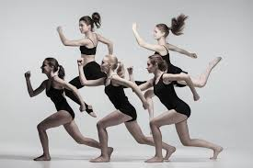
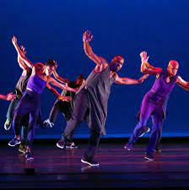
Year 4– Physical Education – Spring 1: Dance
Activity:
What do I know already?
We have performed pair/group dances
We responded to music in a range of ways to show feeling, mood and rhythm.
What will I learn?
We will respond imaginatively to stimuli related to character, music and story in our dances
We will perform clear and fluent dances and make up our own in a small group.
We will compare our performances with previous ones and demonstrate improvement to achieve our personal best.
Key words: stimuli, fluency, rhythm, critique, flexibility, strength, control, balance
Key Questions:
How do you give feedback to someone whilst still considering their feelings?
What stimuli did you use to create your dance?
What emotions or feeling do you think people watching your dance will feel?

Slide 5
Year 4– Physical Education – Summer 1: Athletics
Humans – keeping healthy
Activity:
Key Questions:
In what event would you use a baton?
Can you describe the difference between a shotput and javelin?
What do I know already?
We have learnt to run in different directions, speed and distances using good technique.
We have improved our throwing technique and reinforced our jumping technique.
We understand the different aspects of a relay race.
Key words:
Footwork, accuracy, pace, effective technique, competitor.
What will I learn?
We will learn to select and maintain a pace for running different distances.
We will develop throwing with power and accuracy.
We will explore footwork patterns for running, jumping and throwing.
We will demonstrate good techniques within a competitive situation and utilise our skills learned.

Slide 6
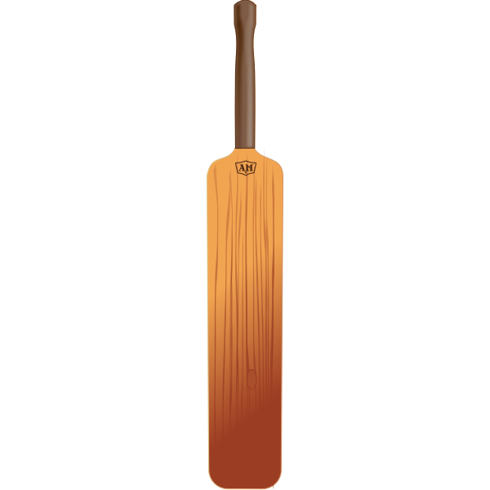
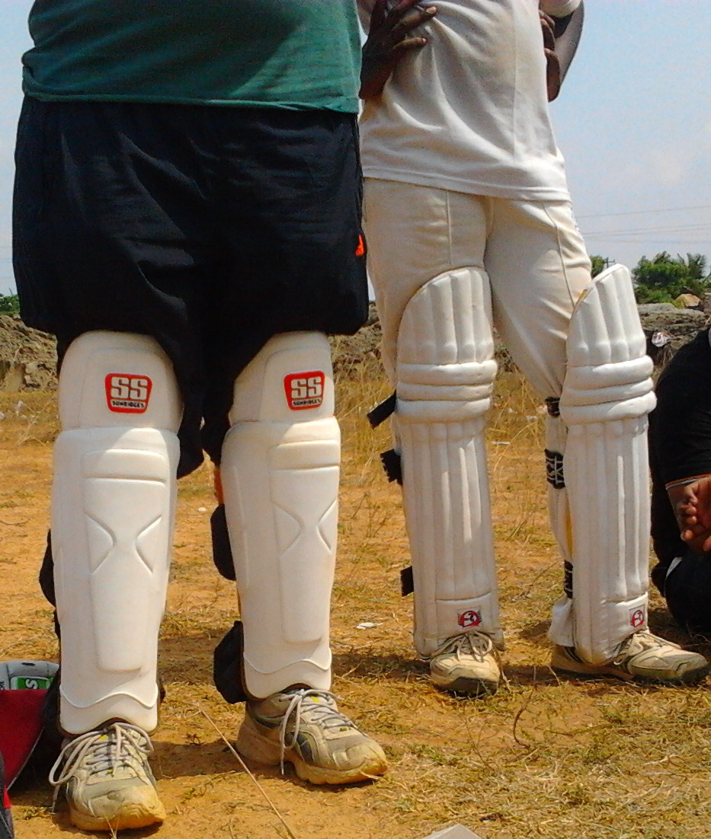
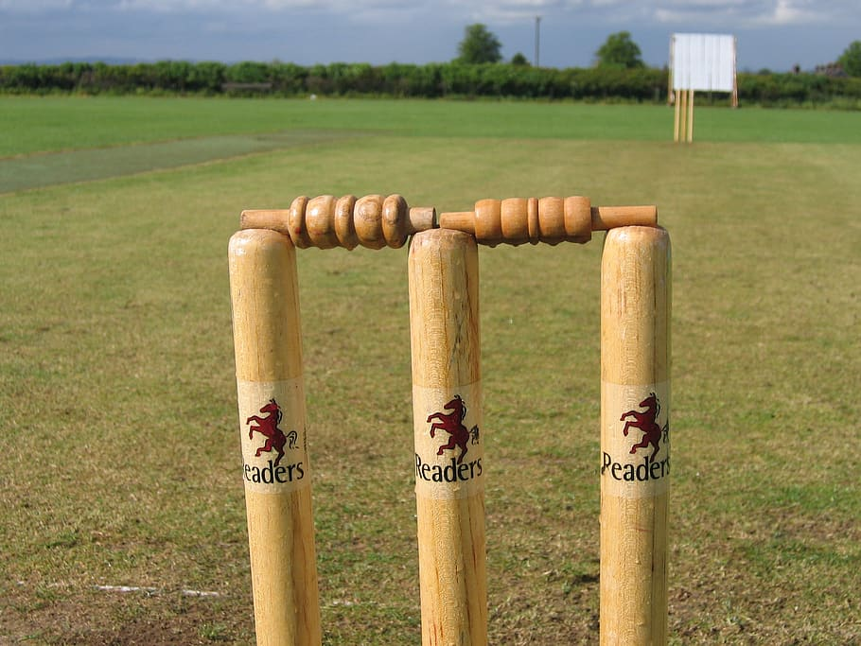
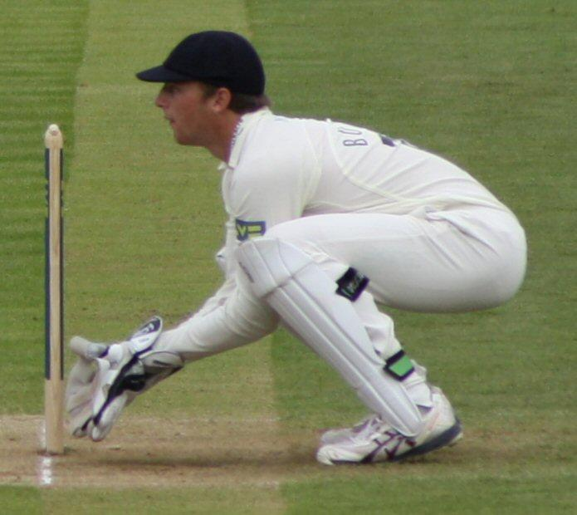
Year 4– Physical Education – Summer 1: cricket
What I will learn:
Hand-Eye Coordination
Batting Technique
Hand-Eye Coordination with Throwing & Catching
Bowling Technique (Fast, Swing, and Spin)
Fielding
Wicket-keeping
Key learning:
Excellent hand-eye coordination.
A sense of anticipation.
High levels of concentration.
Quick reflexes.
Good sprinting speed.
An ability to catch a cricket ball reliably.
An ability to throw the ball accurately.
wickets
Cricket bat
shin pads
Key words:
decision making
tactics
Hand - eye coordination
bowling
batting
wicket- keeping
fielding
This is a wicket keeper. It is a fielding position and you have to be good at catching a ball.

Slide 7
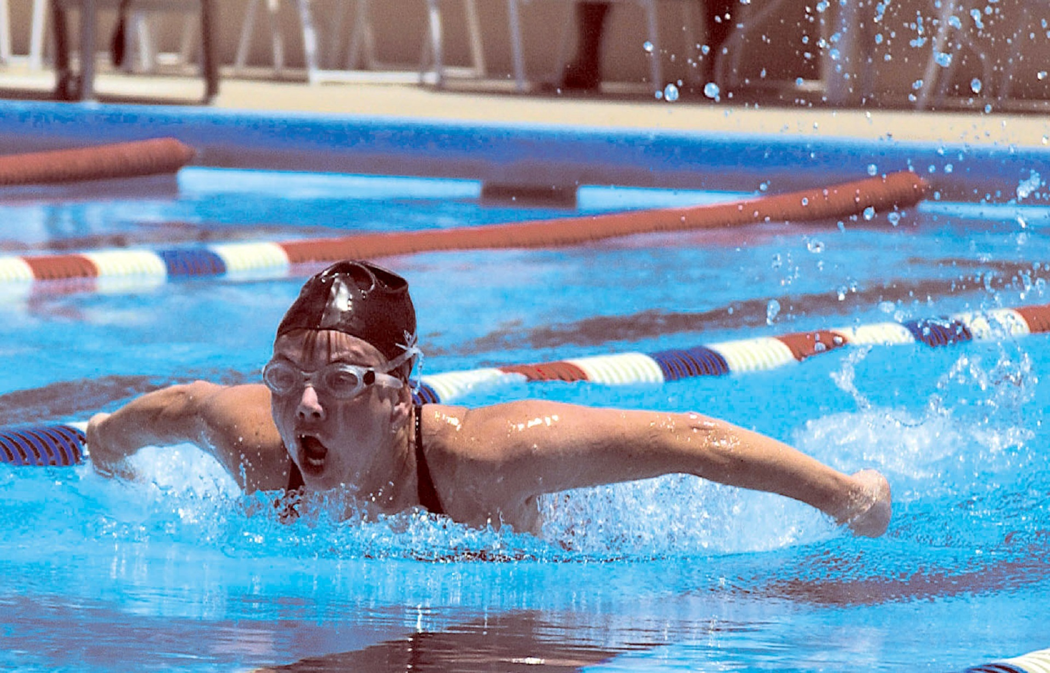
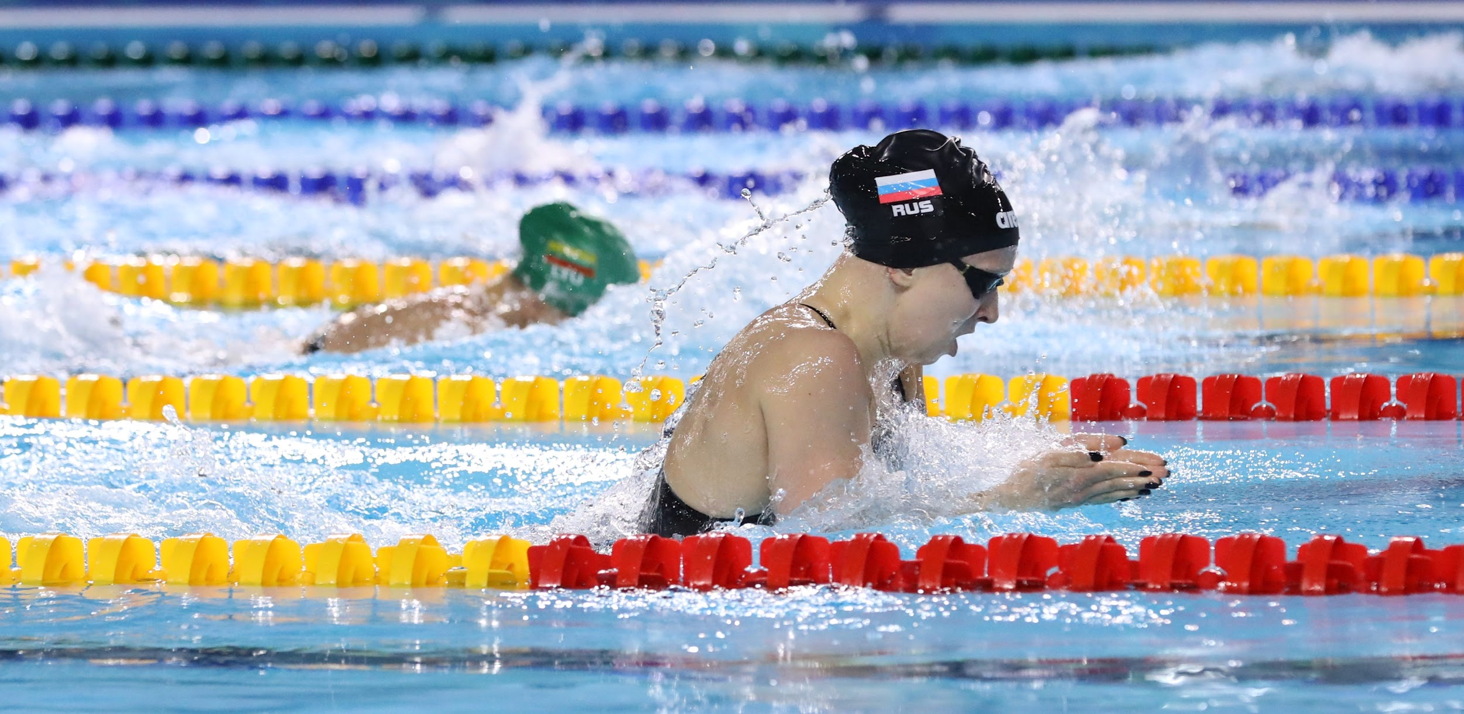
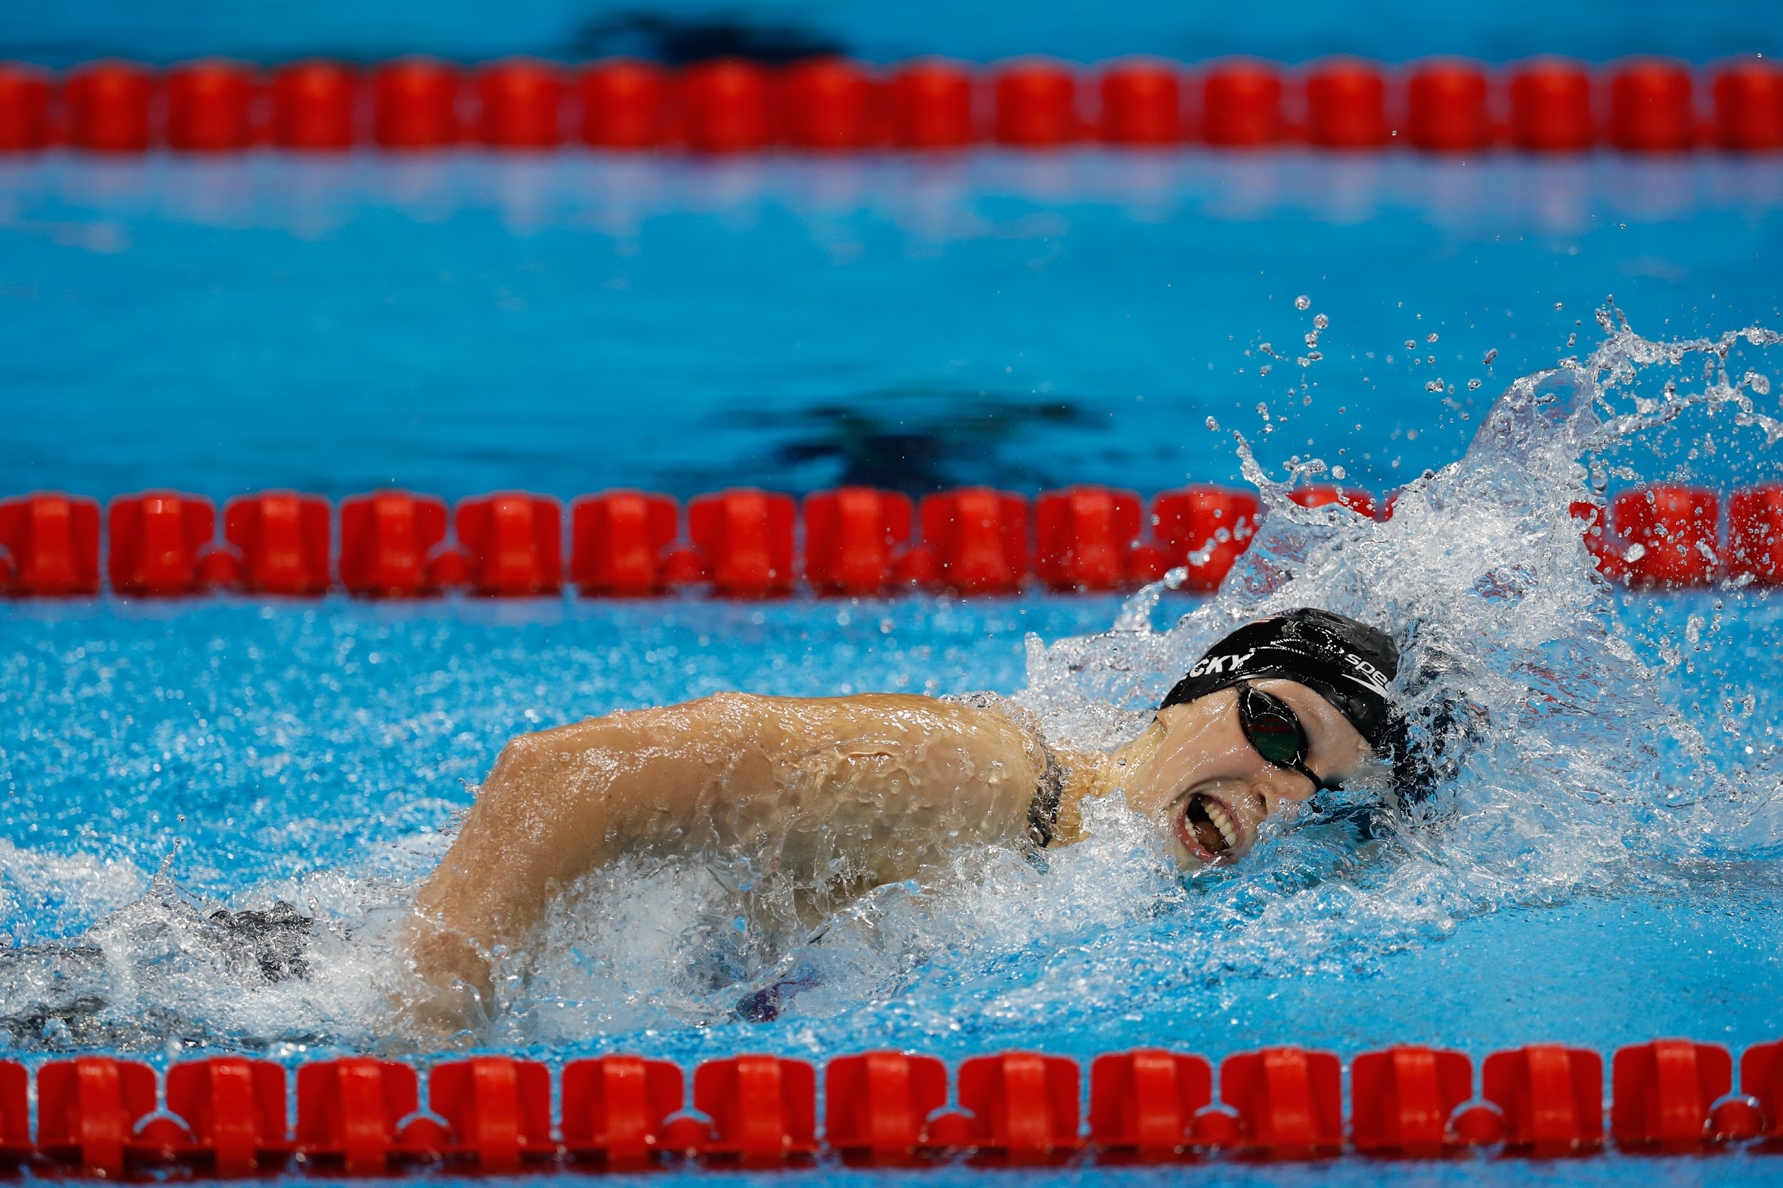
Year 4– Physical Education – Summer 2 : swimming
What I will learn:
To stay safe in the water I must listen carefully and follow the pool rules.
To improve my swimming technique I must practice and think about my breathing as well as my arms and legs.
To swim underwater and on top of the water - using my arms and legs efficiently.
Key learning:
To be successful at swimming I need-
To concentrate.
To control my breathing.
To enter the water and resurface.
To float.
To turn.
To move to safety in the water and exit.
Butterfly stroke Breast stroke
Key words:
safety kicking
float breathing
breaststroke technique
front crawl
butterfly
What have I learnt already? We have been refining our technique when travelling in the water to beginning to use recognised strokes.
This includes how to breathe effectively in the water, use our arms, legs and work on the timings of each movement.
Front crawl in a swimming lane.

